Slide 1
Lending Club - Case Study EDA - Presentation
Contributors:
Uday kumar adavi
bibhu sundar sahoo

Slide 2
Lending Club business
Business Understanding:
Lending Club is a consumer finance company which specializes in lending various types of loans. The company receives a loan application, the company must decide for loan approval based on the applicant’s profile. Certain factors of risks are associated while making this decision.
Loss of business - Applicant is likely to pay the loan, and company is not approving the loan.
Financial Loss - Applicant may default on the loan, i.e. not pay.
Objective:
Identify driving factors(strong indicators) behind loan defaults.
identify risky loan applicants.

Slide 3
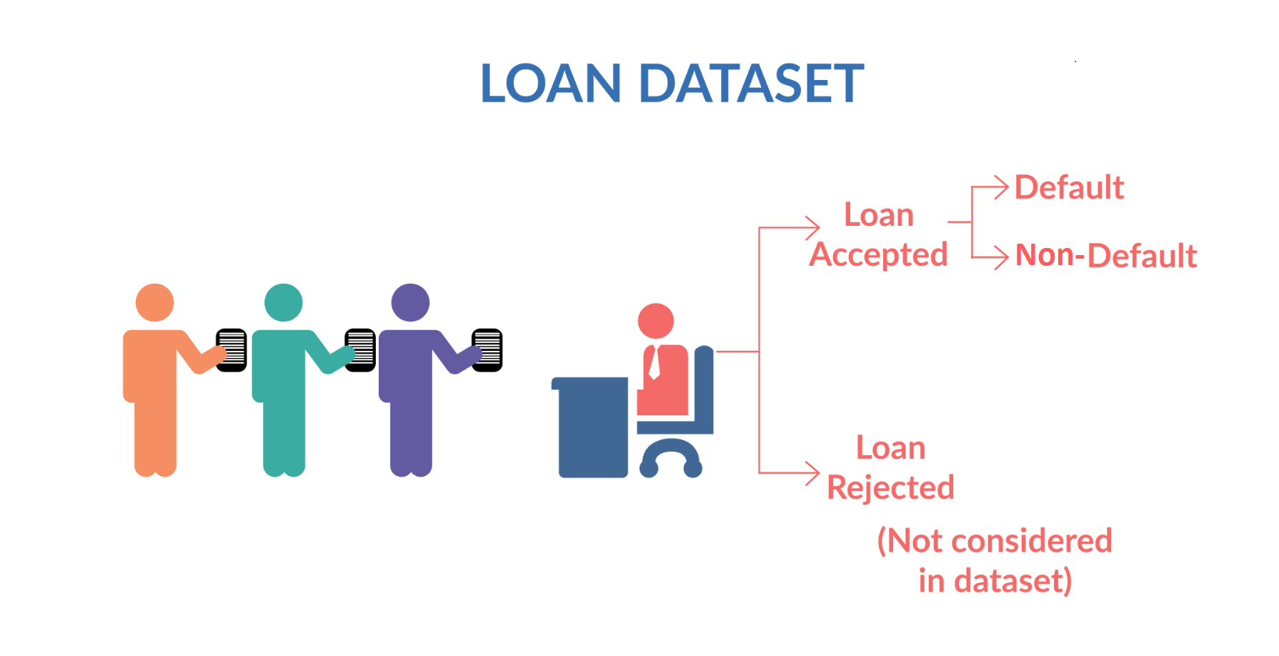
Problem statement
To do, exploratory data analysis to the past loan applicant’s dataset to understand consumer attributes and loan attributes that influence loan defaults.
When a person applies for a loan, there are two types of decisions that could be taken by the company:
Loan accepted
Loan rejected
Finding Default!!
aka defaulters, someone
not paying installments.

Slide 4
Indicator of loan defaults
Consumer Attributes
Employee Length
Loan Attributes
Loan Purpose
Interest rate

Slide 5
Finding and recommendation
Any loan applicant with annual income less than 100K should go through heightened scrutiny
It's risky to offer loan to applicants with higher DTI and Loan to income ratio.
The higher default rate in high interest rate category evidently says it's risky to offer high interest loan to customers.
Any loan applicant who has a credit age below 5 years should go through heightened scrutiny.

Slide 6
Data Analysis- Numerical
Example of numerical variable and how we analysed it, came up with findings, insights & recommendation
All related charts form python notebook
Write some text box comments

Slide 7
Data Analysis- Categorical
Example of numerical variable and how we analysed it, came up with findings, insights & recommendation
All related charts form python notebook
Write some text box comments

Slide 8
Final summary slide – can be the same as the summary table in the python note book

